Slide 1
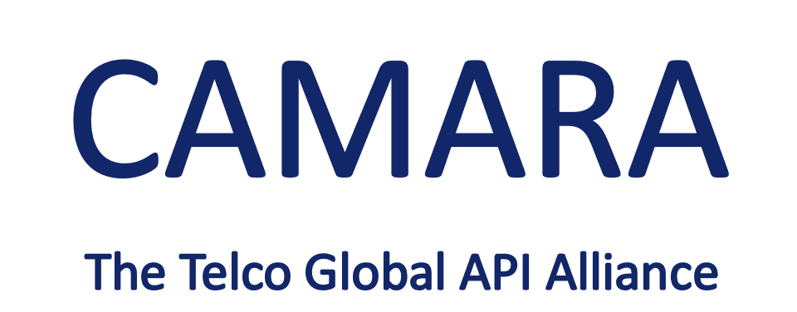




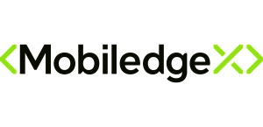

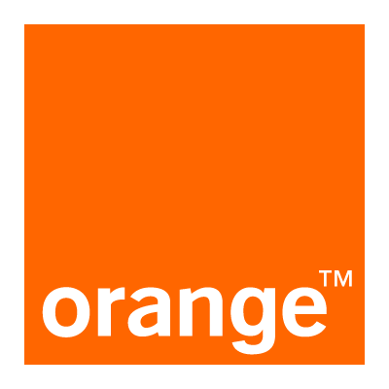







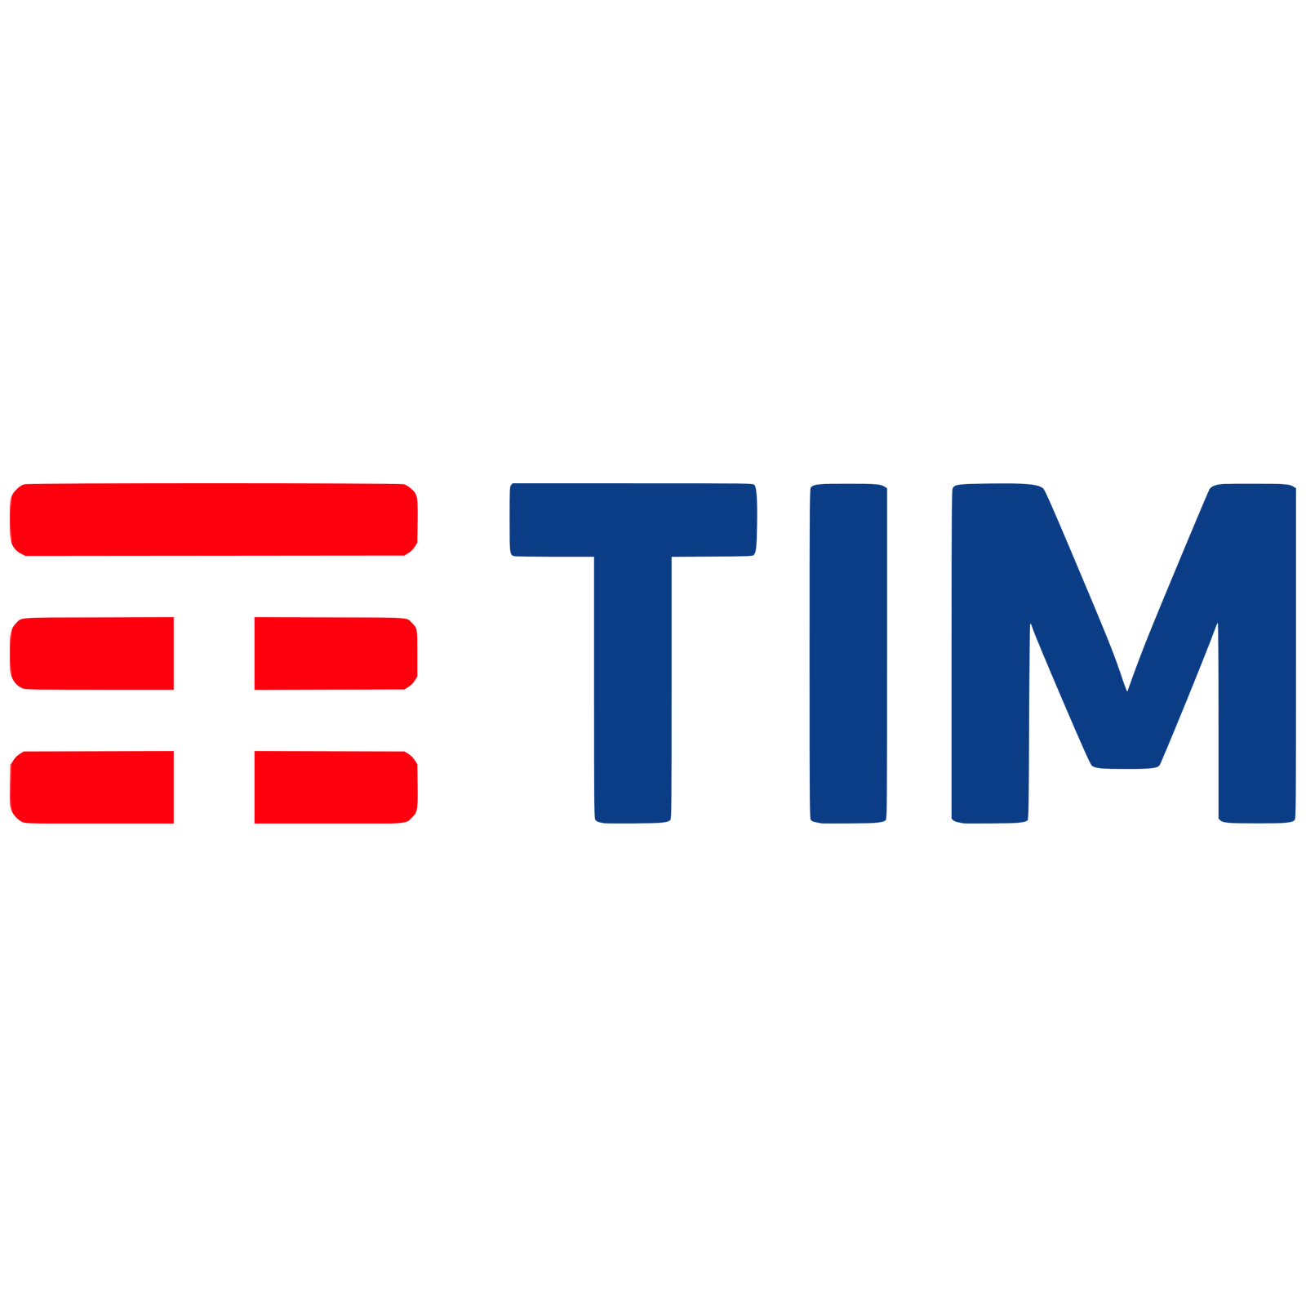
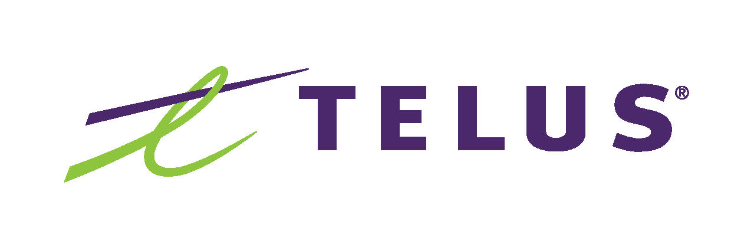
0
Enable seamless access to
4G/5G network capabilities
4G/5G network capabilities exposed through APIs provide a large benefit for customers. By hiding telco complexity behind APIs and making the APIs available across telco networks and countries, CAMARA enables an easy and seamless access.
4G/5G network capabilities are functions partly available already in 4G but new and much more powerful in the 5G network. These functions enable to get information out of the network but also to configure the network. The on-demand, secure and controlled exposure of these capabilities pave the way for transforming operator networks into service enablement platforms, facilitating the application-to-network integration, which will be key to deliver enhanced and service-tailored customer experience in the 5G era.
CAMARA is an open source project within Linux Foundation to specify, develop and test the APIs. CAMARA works in close collaboration with the GSMA Operator Platform Group to align API requirements and publish API specs and APIs. Harmonization of APIs is achieved through fast and agile created working code with developer-friendly documentation. API specs and reference implementations are free to use (Apache2.0 license).
Abstraction from Network APIs to Service APIs is necessary:
To hide telco complexity making APIs easy to consume for customers with no telco expertise (user-friendly APIs)
To fulfil data privacy and regulatory requirements
To facilitate application to network integration
Availability across telco networks and countries is necessary:
To ensure seamless customer experience
To accelerate technology development and commercial adoption (minimize implementation effort)
To accelerate education and promotion
To support application portability
11.02.2022

